Slide 1

Stock Return Prediction in Machine Learning – Group 7
Zhang Runmin 119020073 Zhou Xitong 120030067
Yu Kangqi 121090735 Gu Tianxia 121090146
Xiang Chuyi 121090630 Di Xinyue 121020039
Chen Bingshang 121090026 Zhan Yufei 121090759
Lou Nan 121090380 Chen Nuo 121020014

Slide 2
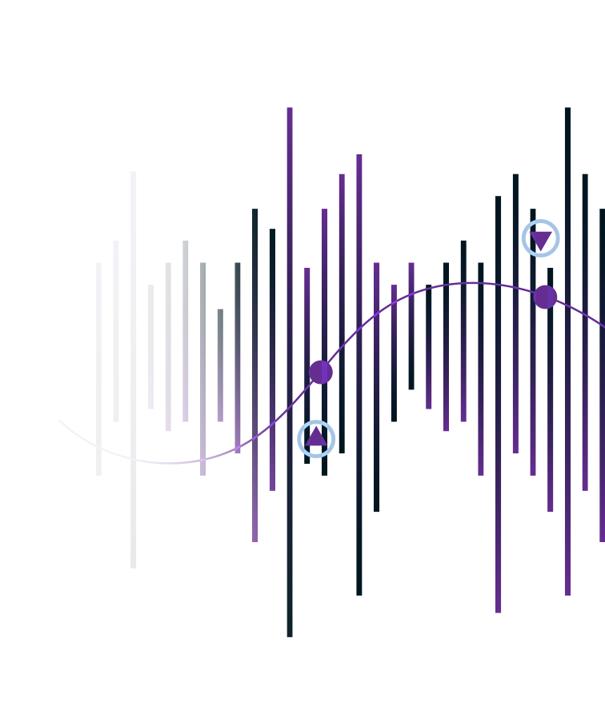
Table of contents
01
04
02
05
03
06
Stocks and Factors
Tree Models
Baseline - APT
Deep Learning
Regularized Linear Models
Outsample Test and Conclusion

Slide 3
01
Stocks and Factors

Slide 4
Stock Selection
We have chosen ten stocks from the automotive industry, as this may potentially yield better factor performance, offer comparability, and eliminate the need for industry neutralization.
Stock Code | 002594.SZ | 601633.SH | 600104.SH | 000625.SZ | 601238.SH
Stock Name | 比亚迪 | 长城汽车 | 上汽集团 | 长安汽车 | 广汽集团
Stock Code | 000338.SZ | 600660.SH | 600418.SH | 601689.SH | 000951.SZ
Stock Name | 潍柴动力 | 福耀玻璃 | 江淮汽车 | 拓普集团 | 中国重汽

Slide 5
Dataset Introduction
Data Source
WIND
CSMAR
Data Range
2016.1.1 to 2022.12.31
Data Processing
The return data is constructed manually through the close price data from WIND database.
The three momentum factors are constructed manually from the close price data and the related return data.
The periodical/quarter factors are constructed through data from the last period.

Slide 6
Factor introduction
Factor filtration
We computed the correlation between the return and the factors, and chose factors with IC>0.01, IR>0.03.
Total 27 factors
IC_{A} = Corr(f_{A}, r)
f_{A}：Factor A loading at time t
r ：Stock return at time t+1
IR_{A} = Mean(IC_{A})/STD(IC_{A})
6 valuation factors
3 momentum factors
6 risk analysis factors
12 financial analysis factors

Slide 7
Factor introduction
Factor | Classification | Frequency | Description
Dividend Yield(%) | Valuation Factor | Daily | Total annual dividend payments/ Stock market capitalization
val_lnmv | Valuation Factor | Daily | Logarithmic market capitalization
val_lntotassets | Valuation Factor | Periodically | Logarithmic total assets
val_ortoev_ttm | Valuation Factor | Daily | Operating Income (TTM)/Enterprise Value
dividendyield2 | Valuation Factor | Daily | Dividend Yield (12 Months)
val_floatmv | Valuation Factor | Daily | Floating Market Cap_PIT
20day_momentum | Momentum Factor | Daily | 20-Day Momentum = Closing Price of the day / (Average of the previous 20 days' closing prices)
mmt_discret_W | Momentum Factor | Daily | One-week information dispersion momentum: the difference between the number of days with positive returns and the number of days with negative returns in the past five trading days.
Vol_up_std_M | Momentum Factor | Daily | One-month upward volatility: the standard deviation of positive returns over the first twenty trading days

Slide 8
Factor | Classification | Frequency | Description
risk_variance20 | Risk Analysis | Daily | 20-Day Variance_PIT
risk_lossvariance20 | Risk Analysis | Daily | 20-Day Loss Variance_PIT
risk_beta20 | Risk Analysis | Daily | 20-Day Beta_PIT
risk_volatilityratio | Risk Analysis | Daily | Ratio of Individual Security Volatility and Market Volatility_PIT
risk_hisrelation | Risk Analysis | Daily | 252-Day Correlation between Individual Security and the Market_PIT
risk_revsvarratio | Risk Analysis | Daily | 30-Day Variance / 120-Day Variance_PIT
fa_cashrecovratio_ttm | Financial Analysis | Periodically | Cash Recovery Ratio (TTM)_PIT
fa_blev | Financial Analysis | Periodically | Book Leverage_PIT
fa_current | Financial Analysis | Periodically | Current Ratio_PIT
fa_apturn_ttm | Financial Analysis | Periodically | Accounts Payable Turnover (TTM)_PIT
fa_ncgr_ttm | Financial Analysis | Periodically | Growth Rate - Net Cash Flow (TTM)_PIT

Slide 9
Factor | Classification | Frequency | Description
fa_salestocost_ttm | Financial Analysis | Periodically | Cost of goods sold ratio (TTM)
fa_sellexpensetogr_ttm | Financial Analysis | Periodically | Selling expenses/total operating income (TTM)
evebit | Financial Analysis | Quarterly | Enterprise Value multiplier: Total market value/EBITDA
fa_operincometopbt | Financial Analysis | Periodically | Net Income from Operating Activities / Total Profit_PIT
fa_octogr_ttm | Financial Analysis | Periodically | Total Operating Cost / Total Operating Revenue (TTM)_PIT
fa_netprofitmargin_ttm | Financial Analysis | Periodically | Net Profit Margin (TTM)_PIT
fa_salescashtoor | Financial Analysis | Periodically | Cash Received from Sales of Goods and Rendering of Services / Operating Revenue_PIT

Slide 10
02
Baseline - APT

Slide 11
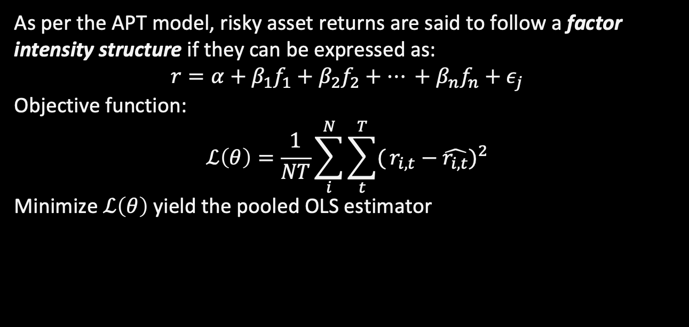
APT Model (Simple Linear)
As per the APT model, risky asset returns are said to follow a factor intensity structure if they can be expressed as:
$$r=α+β_{1}f_{1}+β_{2}f_{2}+… +β_{n}f_{n}+ε_{j}$$
Objective function:
$$ℒ\left(θ\right)=\frac{1}{NT}\sum_{i}^{N}{\sum_{t}^{T}{(}{r_{i,t}−\hat{r_{i,t}})}^{2}}$$
Minimize $ℒ\left(θ\right)$ yield the pooled OLS estimator

Slide 12
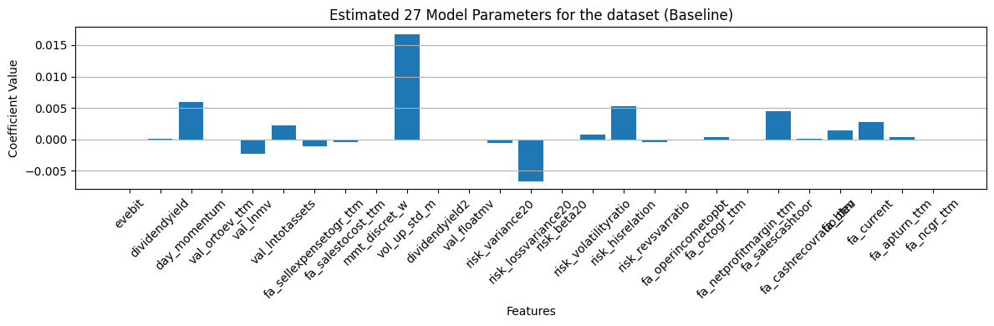
Regression Results
R^2= -0.008846
Mean Squared Error (Baseline): 0.000875

Slide 13
Regularized Linear Models
03

Slide 14
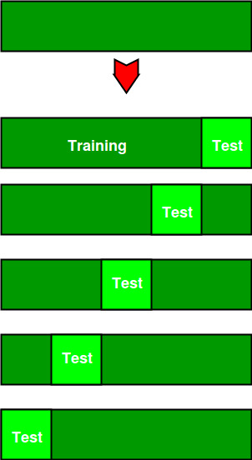
Sample Splitting and Tuning via Validation
Data from 2016 to 2021 for In-Sample Training
Data from 2022 onwards for Out-of-Sample Testing.
Split Training dataset into K-folds
Prediction in the Out-of-Sample (Test) dataset
For each splitting
Tuning parameters
Use (K-1) folds for Training
Always leave 1 fold as Validation
Find the accuracy on each fold to interactively search for optimal hyperparameters

Slide 15
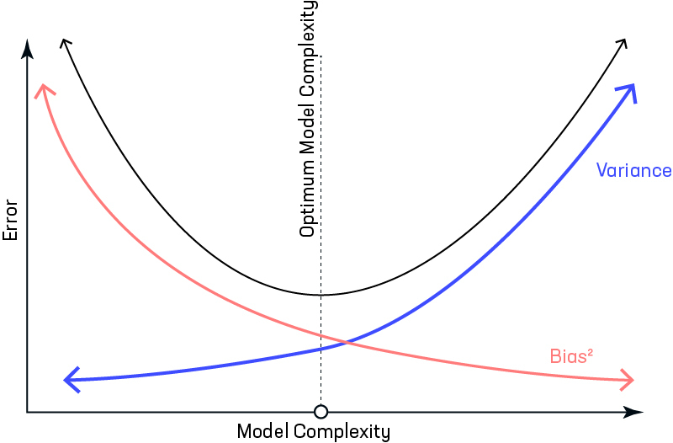
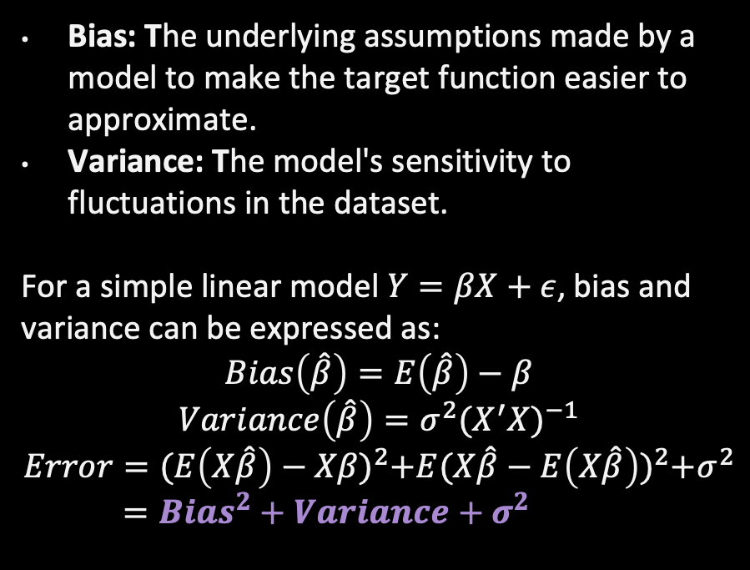
Bias-Variance Trade-Off in Linear Regression
Bias: The underlying assumptions made by a model to make the target function easier to approximate.
Variance: The model's sensitivity to fluctuations in the dataset.
For a simple linear model $Y=βX+ε$, bias and variance can be expressed as:
$$Bias\left(\hat{β}\right)=E\left(\hat{β}\right)−β$$
$$Variance\left(\hat{β}\right)=σ^{2}{{(X}^{′}X)}^{−1}$$
$$Error={(E\left(X\hat{β}\right)−Xβ)}^{2}+E{(X\hat{β}−E\left(X\hat{β}\right))}^{2}+σ^{2}$$
$={Bias}^{2}+Variance+σ^{2}$

Slide 16
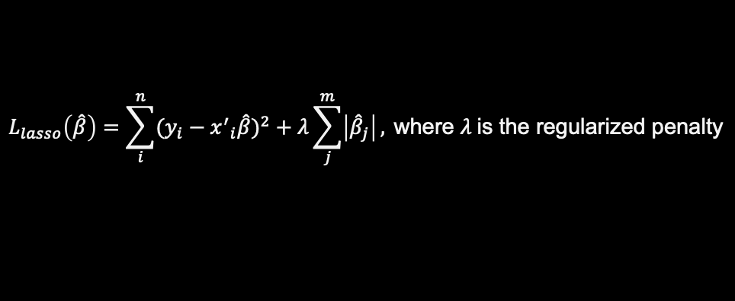
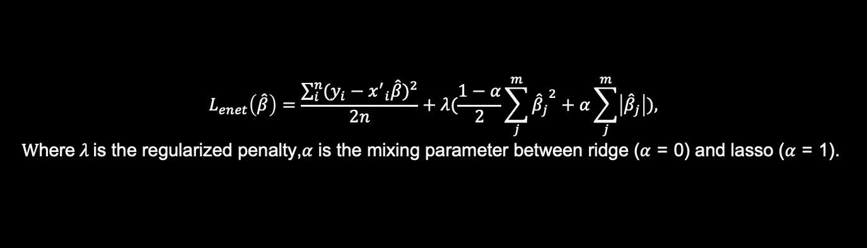
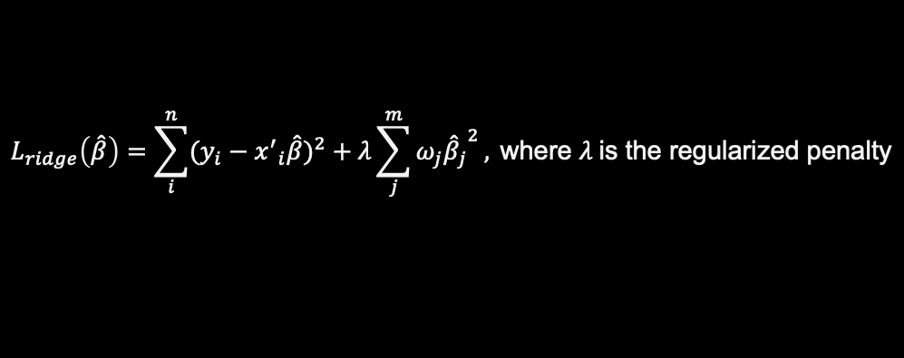
Regularized Linear
Ridge Regression
Lasso Regression
Elastic Net
$$L_{ridge}\left(\hat{β}\right)=\sum_{i}^{n}{{(y_{i}−{x^{′}}_{i}\hat{β})}^{2}}+λ\sum_{j}^{m}{ω_{j}{{\hat{β}}_{j}}^{2}}, \text{where} λ \text{is} \text{the} \text{regularized} \text{penalty}$$
$$L_{lasso}\left(\hat{β}\right)=\sum_{i}^{n}{{(y_{i}−{x^{′}}_{i}\hat{β})}^{2}}+λ\sum_{j}^{m}{\left|{\hat{β}}_{j}\right|}, \text{where} λ \text{is} \text{the} \text{regularized} \text{penalty}$$
$$L_{enet}\left(\hat{β}\right)=\frac{\sum_{i}^{n}{{(y_{i}−{x^{′}}_{i}\hat{β})}^{2}}}{2n}+λ(\frac{1−α}{2}\sum_{j}^{m}{{{\hat{β}}_{j}}^{2}}+α\sum_{j}^{m}{\left|{\hat{β}}_{j}\right|}),$$
$$W\text{here} λ \text{is} \text{the} \text{regularized} \text{penalty}\text{,}α \text{is} \text{the} \text{mixing} \text{parameter} \text{between} \text{ridge}\text{ (}α\text{ = 0) }\text{and} \text{lasso}\text{ (}α\text{ = 1).}$$

Slide 17
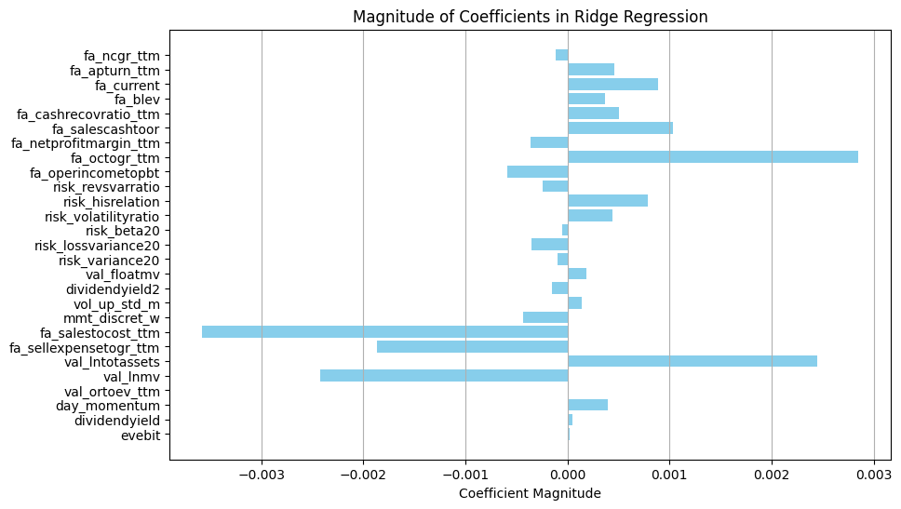
Coefficients (Ridge)

Slide 18
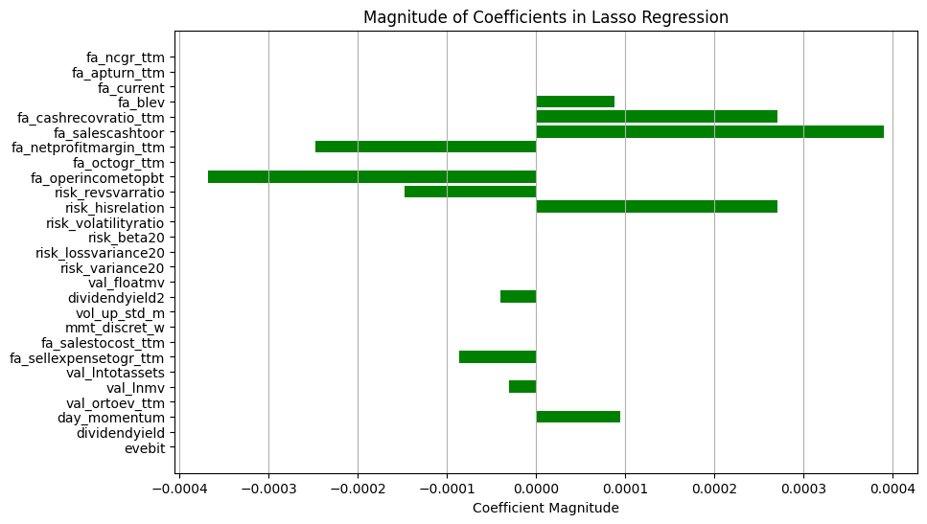
Coefficients (Lasso)

Slide 19
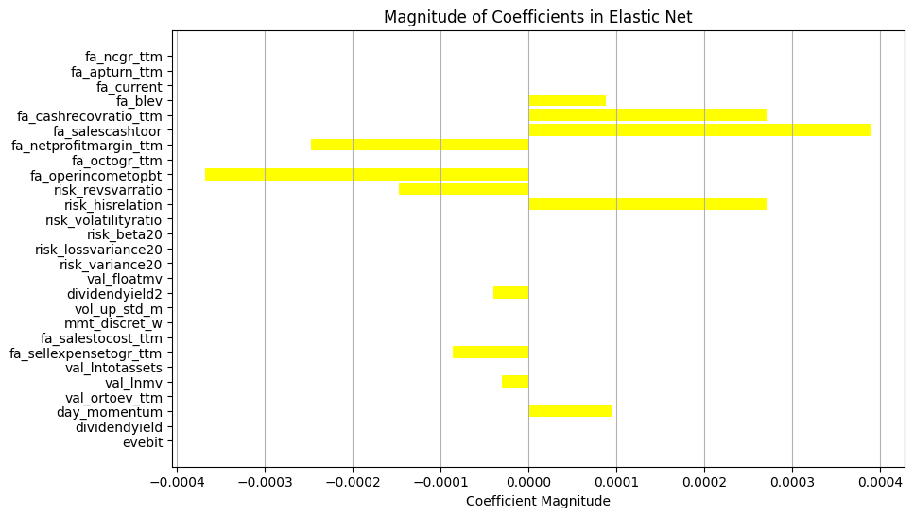
Coefficients (Elastic Net)

Slide 20
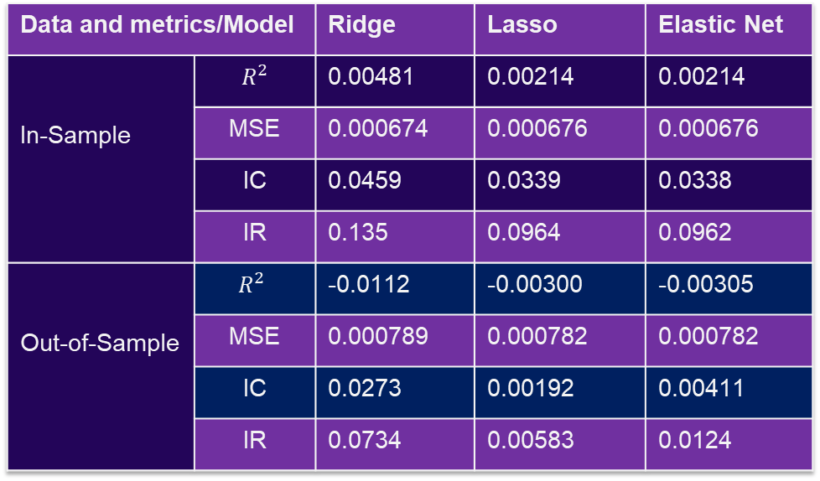
Metrics of Performance
Data and metrics/Model |  | Ridge | Lasso | Elastic Net
In-Sample | $$R^{2}$$ | 0.00481 | 0.00214 | 0.00214
 | MSE | 0.000674 | 0.000676 | 0.000676
 | IC | 0.0459 | 0.0339 | 0.0338
 | IR | 0.135 | 0.0964 | 0.0962
Out-of-Sample | $$R^{2}$$ | -0.0112 | -0.00300 | -0.00305
 | MSE | 0.000789 | 0.000782 | 0.000782
 | IC | 0.0273 | 0.00192 | 0.00411
 | IR | 0.0734 | 0.00583 | 0.0124

Slide 21
04
Tree Models

Slide 22
Traditional Tree Models
Boosting
Bagging
XGBoost, LightGBM, CatBoost
Sequentially combine weak learners
Optimize on the direction of negative gradient
Easy to be overfitting
Random Forest
Constructs multiple decision trees using subsets of the dataset
Reducing overfitting and improving robustness

Slide 23
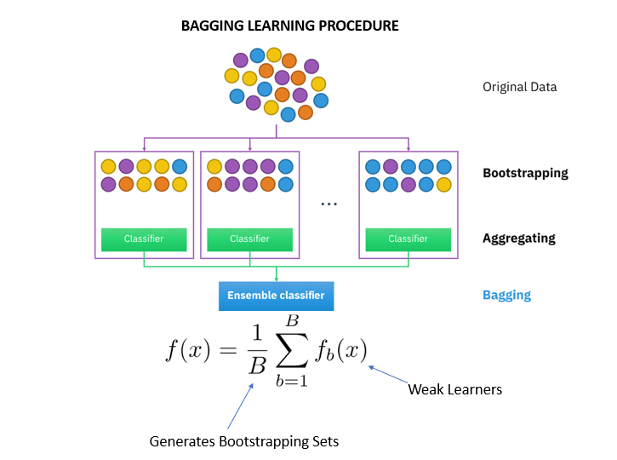
Ensemble Learning
Our tree models
Basic Steps:
Bootstrapping some features and observations out repeatedly
Learn some independent boost models (lightGBM or XGBoost)
Use trained boost models to form a forest, which just like the idea of Random Forest

Slide 24
Feature Engineering
Factors
Time passage
Decaying weight
Our factor team find 27 factors with prediction power covering valuation, risk, momentum and financial analysis.
As almost half of the factors in our pool are periodical, we use the number of days passed after a new quarter as a indicator of the effect of these factors.
The financial market is dynamic. To follow the change of trend in the market. We put more weight to learn the new data.

Slide 25
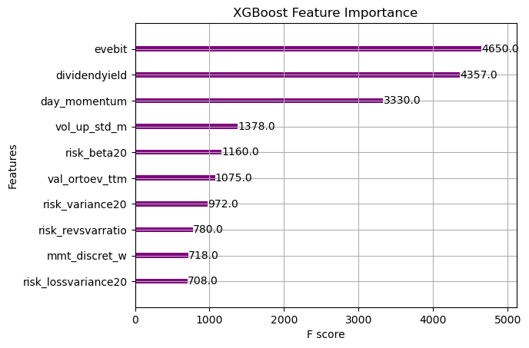
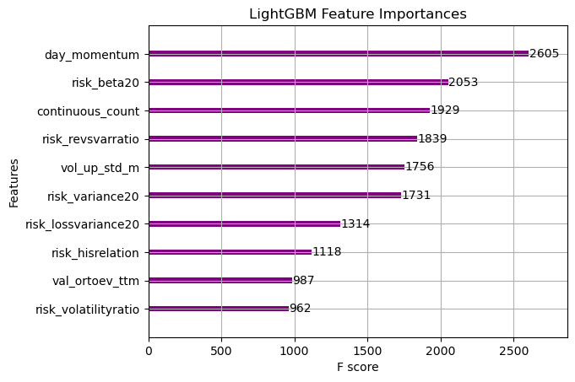
Feature Importance

Slide 26
05
Deep Learning

Slide 27
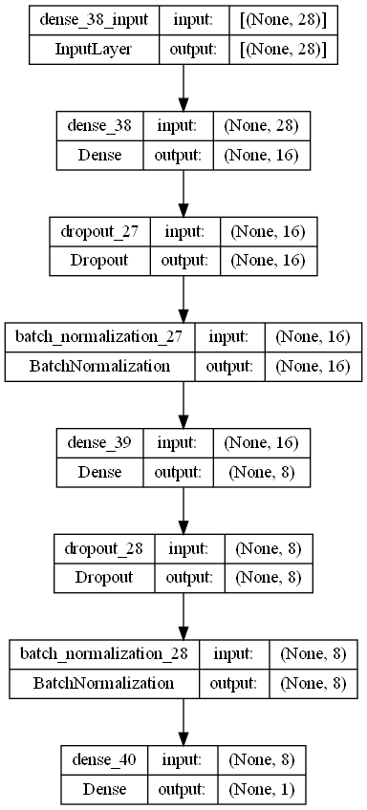
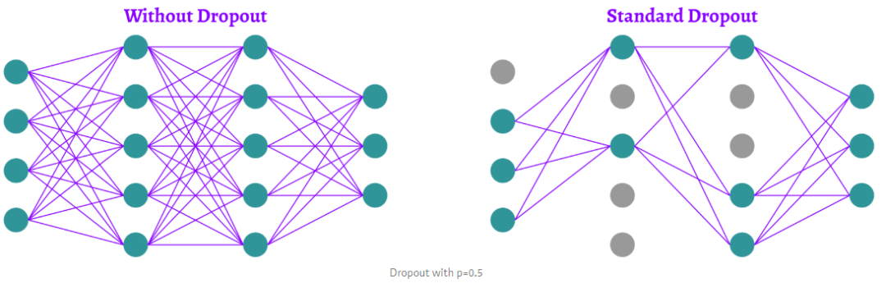
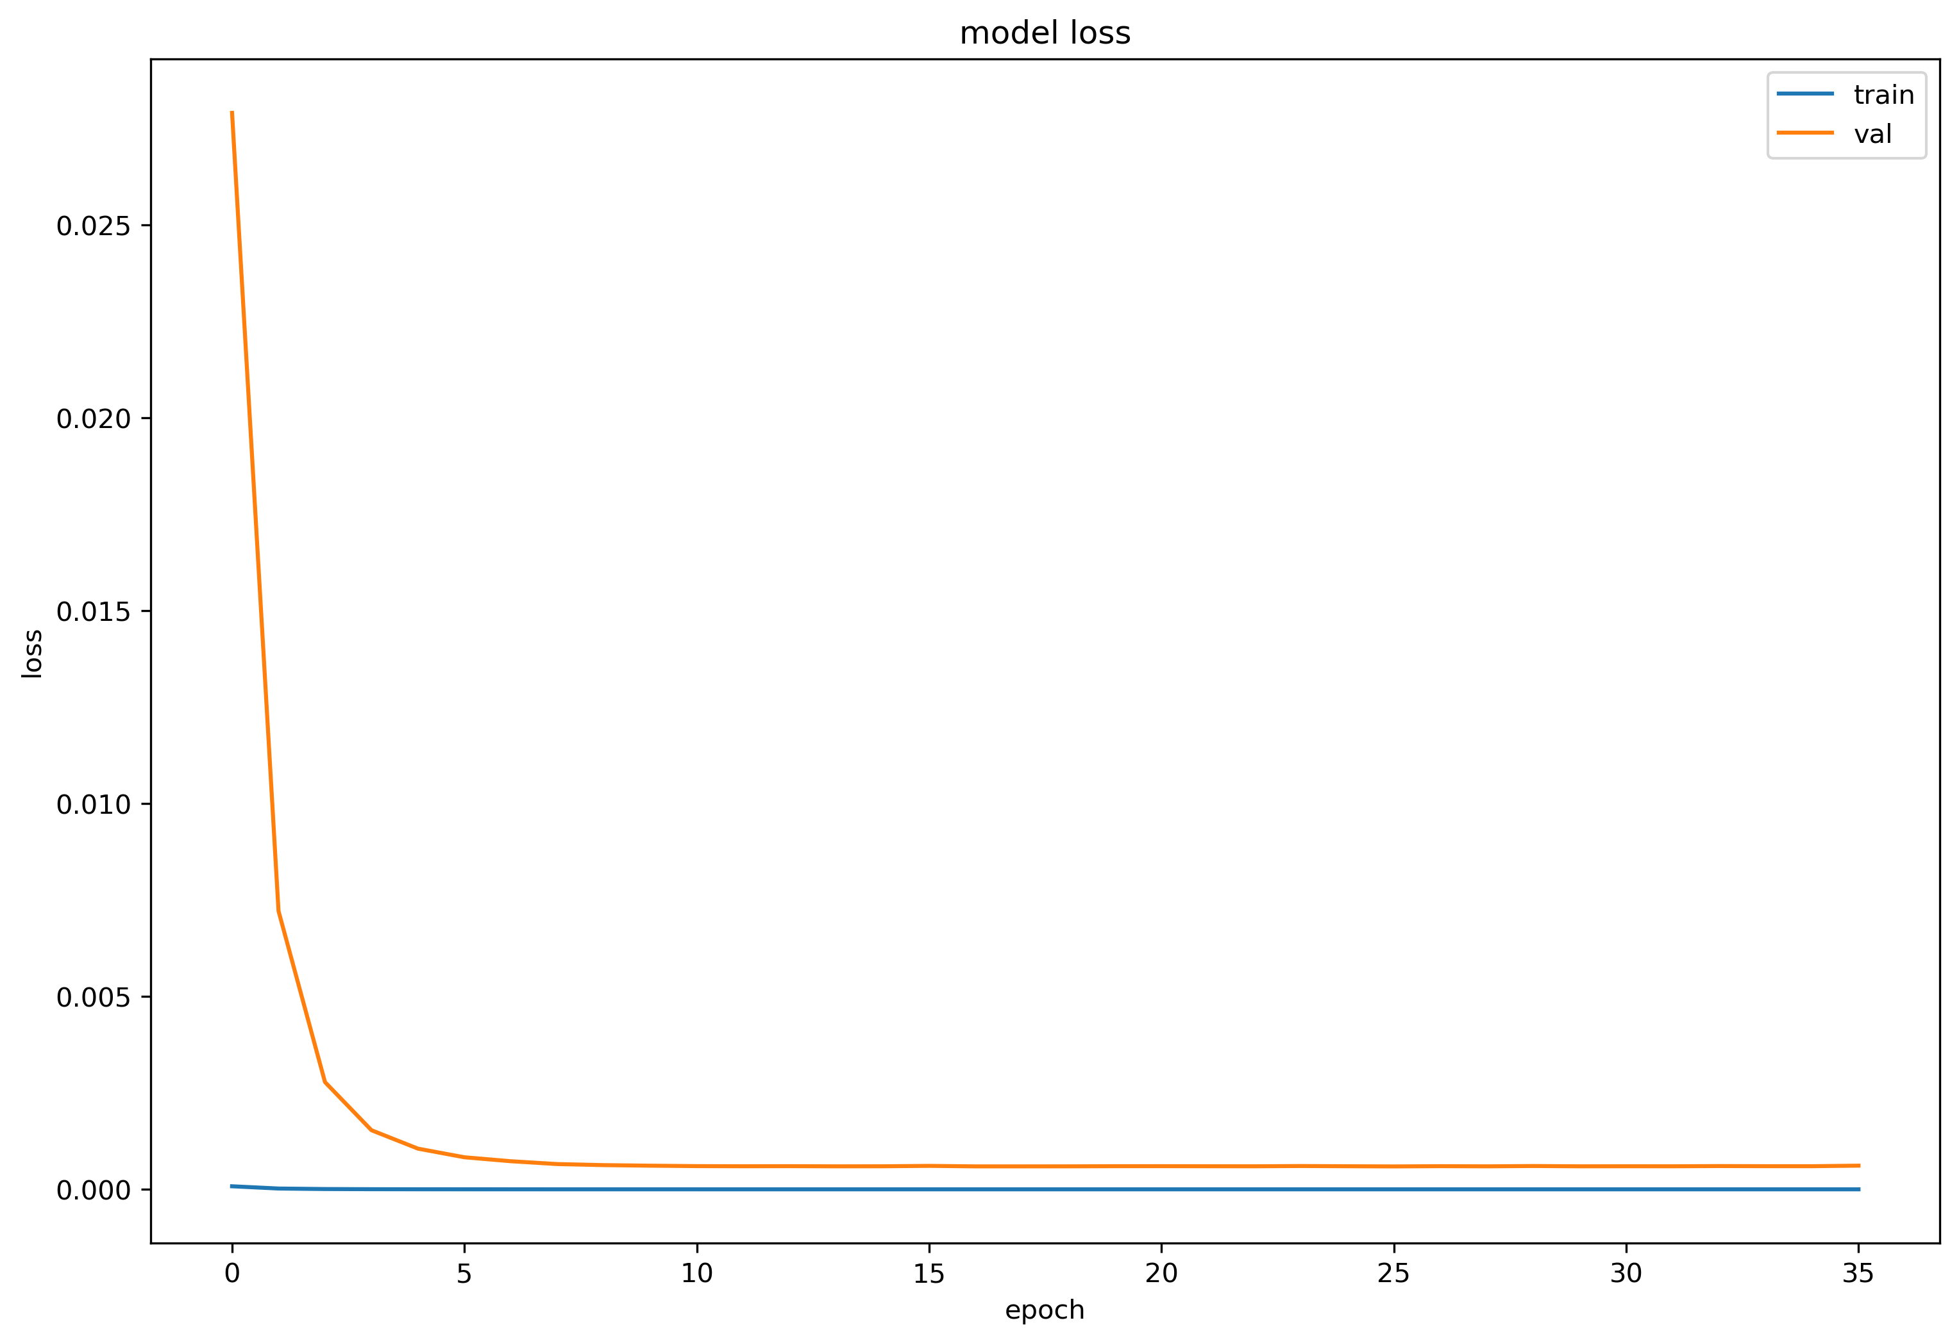

NN
Limited data
Caution with overfitting

Slide 28
CNN
01
02
03
04
Conv layer with 64 filters size of (6, 6)
Maxpooling layer with filters size of (4, 4)
Conv layer with 32 filters size of (4, 4)
Averagepooling layer with filters size of (4, 4)
05
06
07
08
Flatten layer
Dense with 32 nodes
Dense with 16 nodes
Dense with 1 nodes

Slide 29




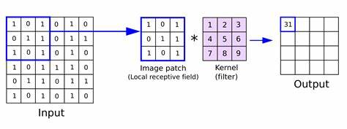
Feature Engineering for CNN
One of the periodical factors
Add the previous time passage feature into here

Slide 30
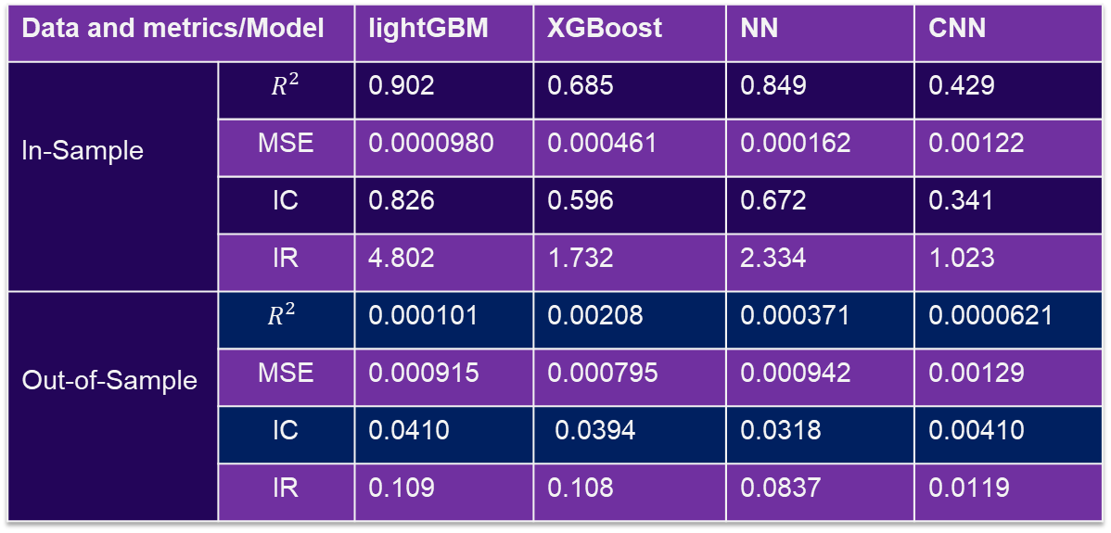
Metrics of Performance
Data and metrics/Model |  | lightGBM | XGBoost | NN | CNN
In-Sample | $$R^{2}$$ | 0.902 | 0.685 | 0.849 | 0.429
 | MSE | 0.0000980 | 0.000461 | 0.000162 | 0.00122
 | IC | 0.826 | 0.596 | 0.672 | 0.341
 | IR | 4.802 | 1.732 | 2.334 | 1.023
Out-of-Sample | $$R^{2}$$ | 0.000101 | 0.00208 | 0.000371 | 0.0000621
 | MSE | 0.000915 | 0.000795 | 0.000942 | 0.00129
 | IC | 0.0410 | 0.0394 | 0.0318 | 0.00410
 | IR | 0.109 | 0.108 | 0.0837 | 0.0119

Slide 31
06
Out-sample Test

Slide 32
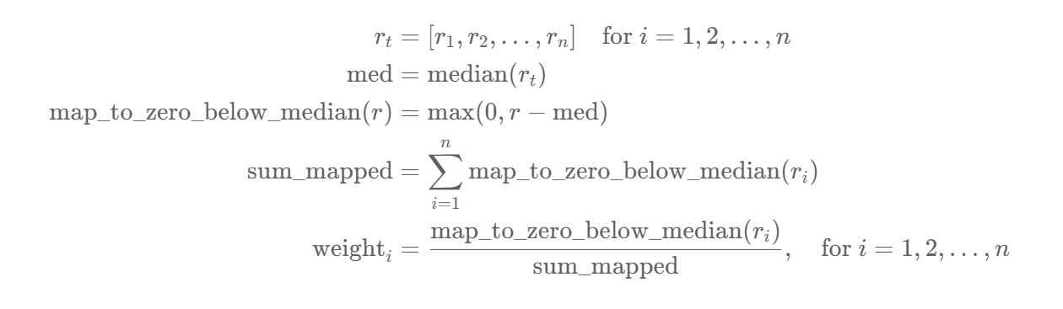
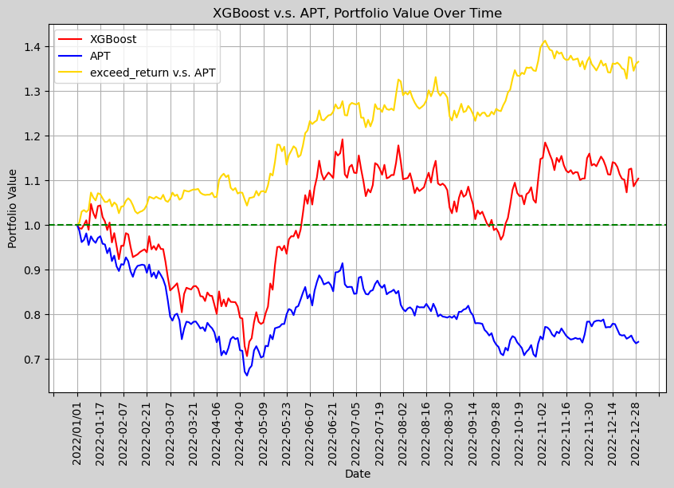
How to evaluate the model? MSE or IC? —— Out-sample backtesting (2022/1/1-2022/12/31)
Portfolio construction strategy
map based on value

Slide 33
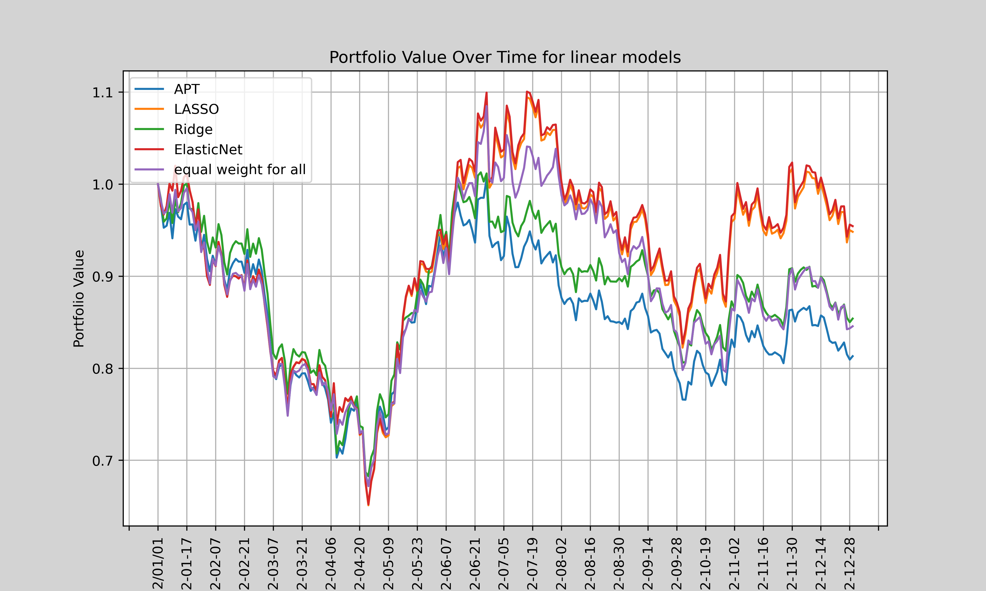
Performance of linear model
Best: LASSO
Over all: LASSO ≈ ElasticNet > Equal weight ≈ Ridge > APT

Slide 34
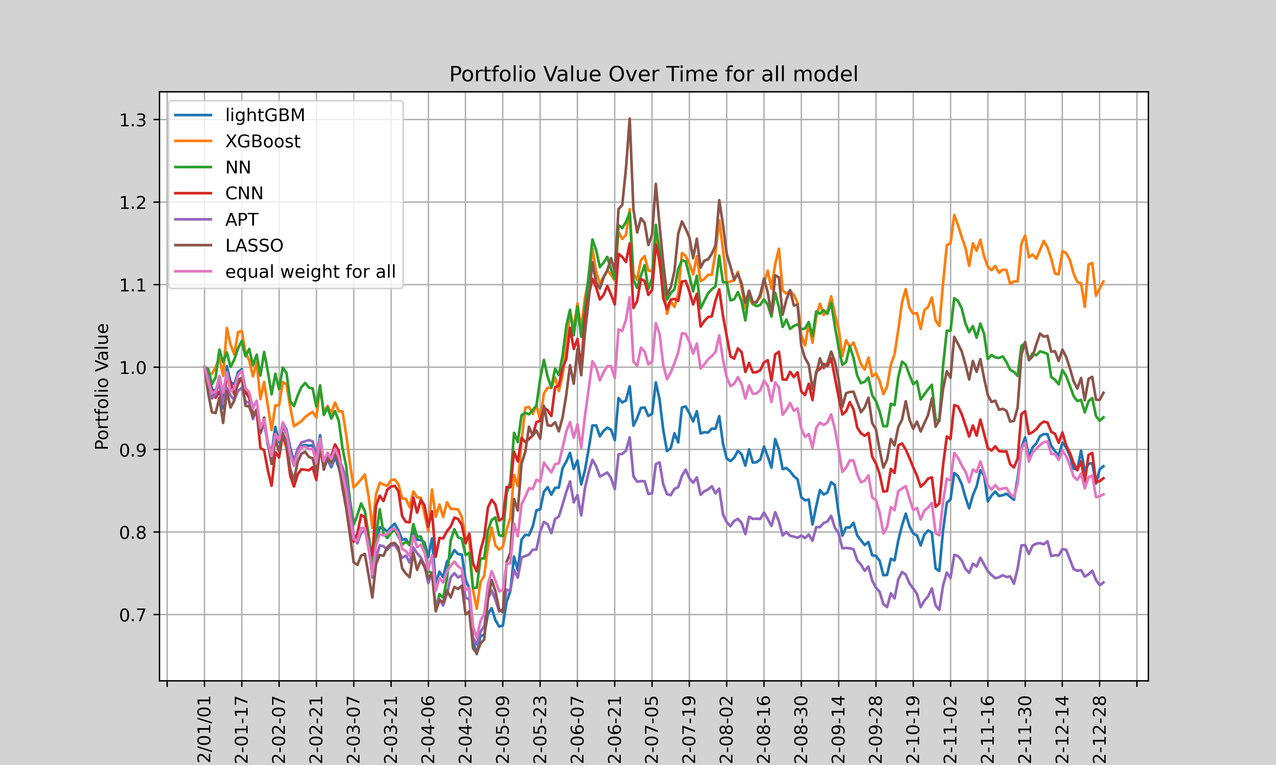
Performance of Machine Learning model
Best: XGBoost
Worst: lightGBM
Over all: XGBoost > NN > LASSO > CNN > Equal weight > lightGBM >APT

Slide 35
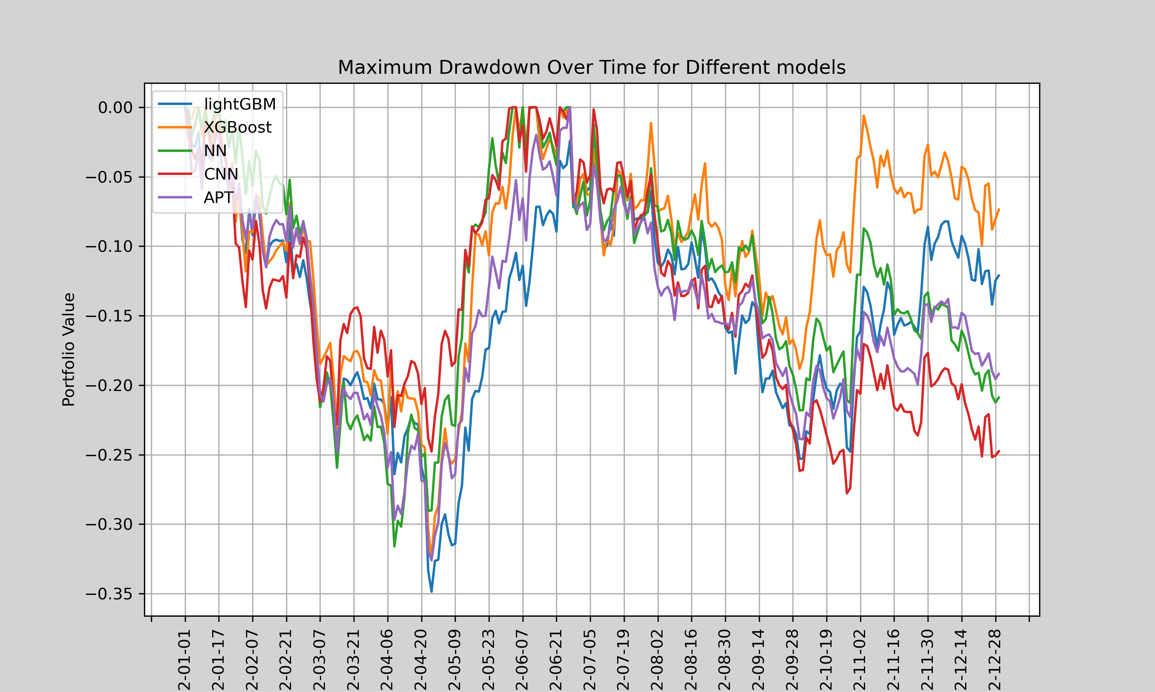
Max drawdown of models
Over all: XGBoost > lightGBM > NN ≈ APT > CNN

Slide 36
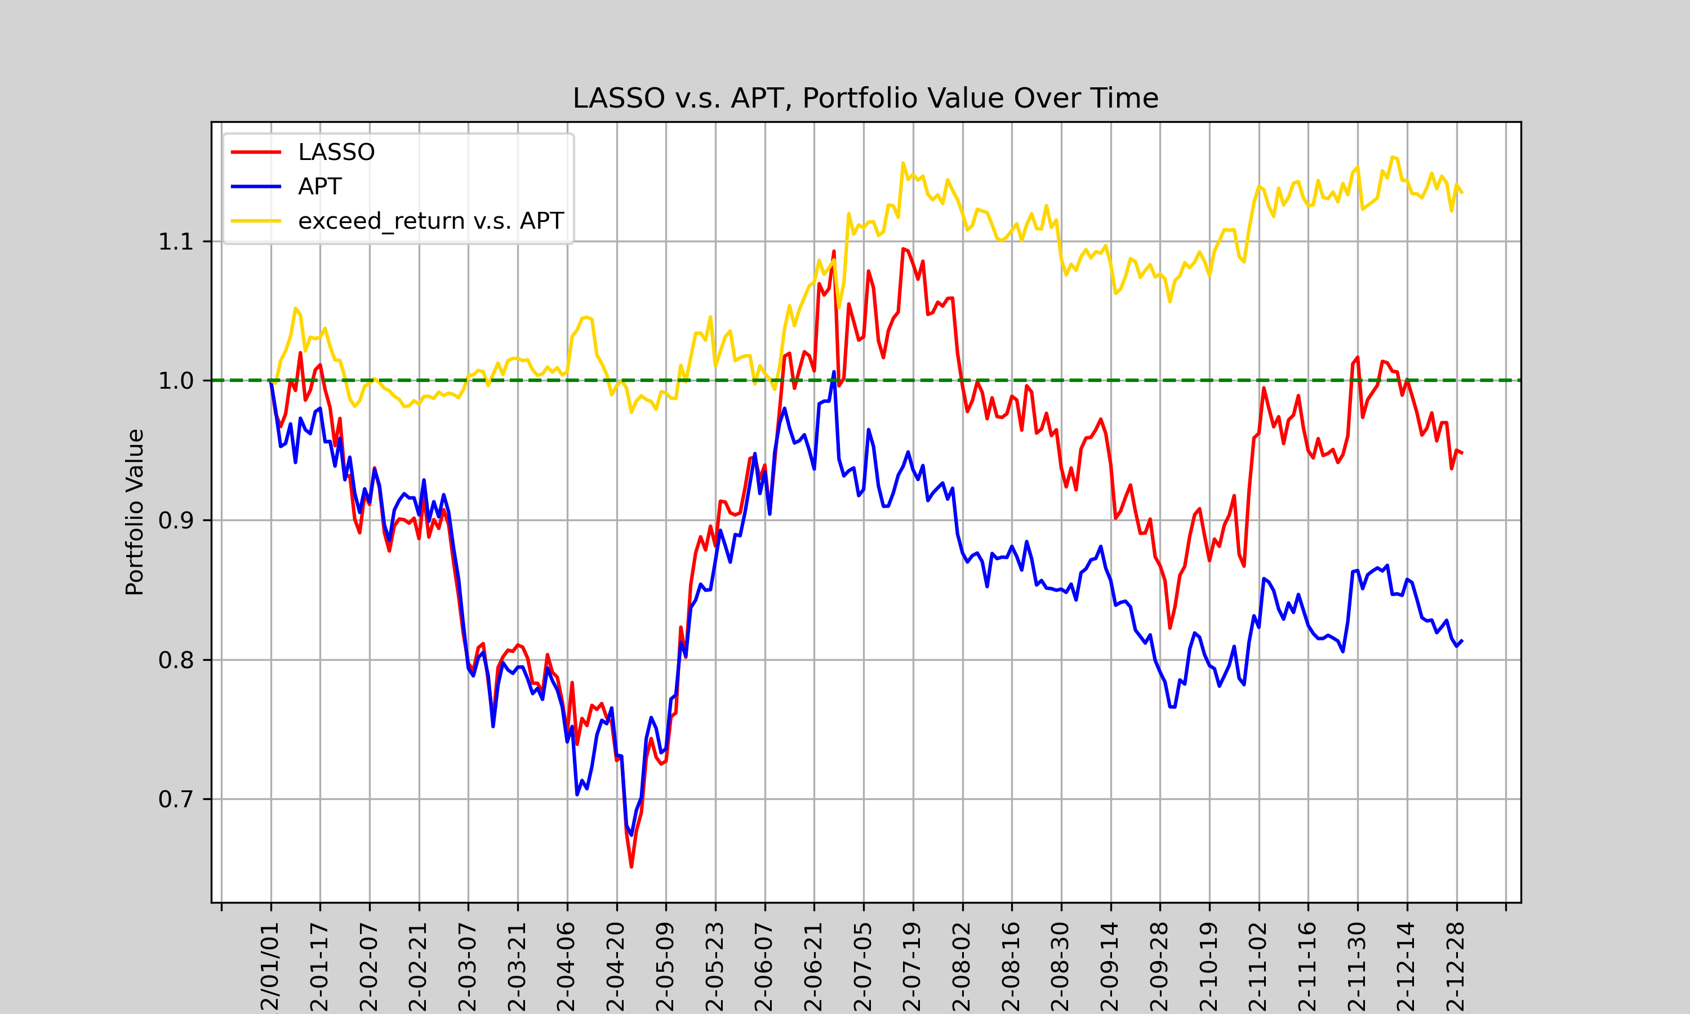
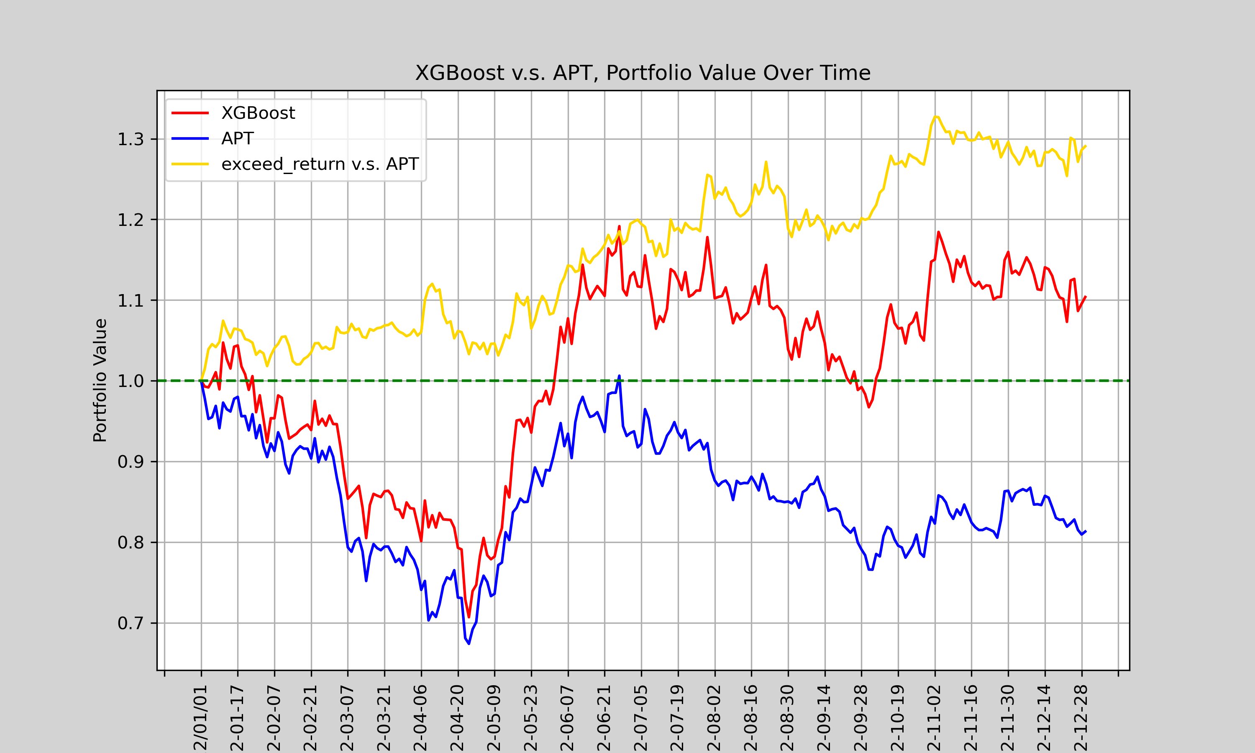
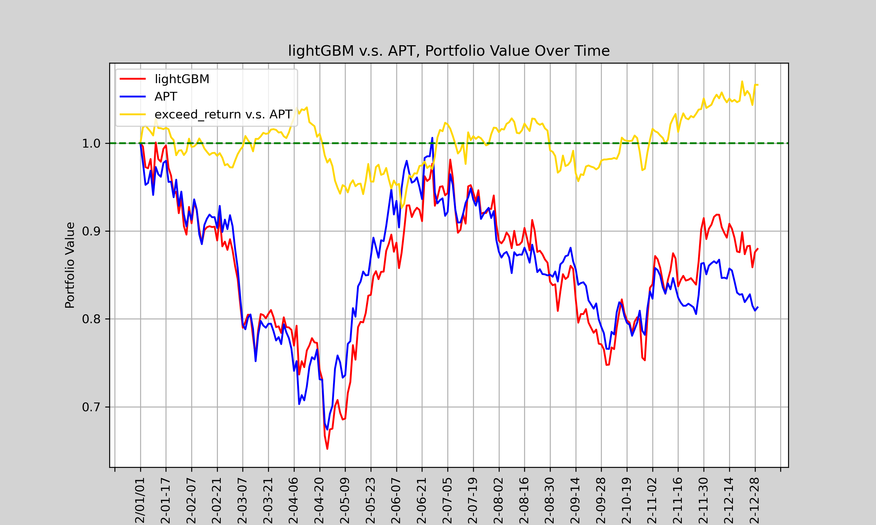
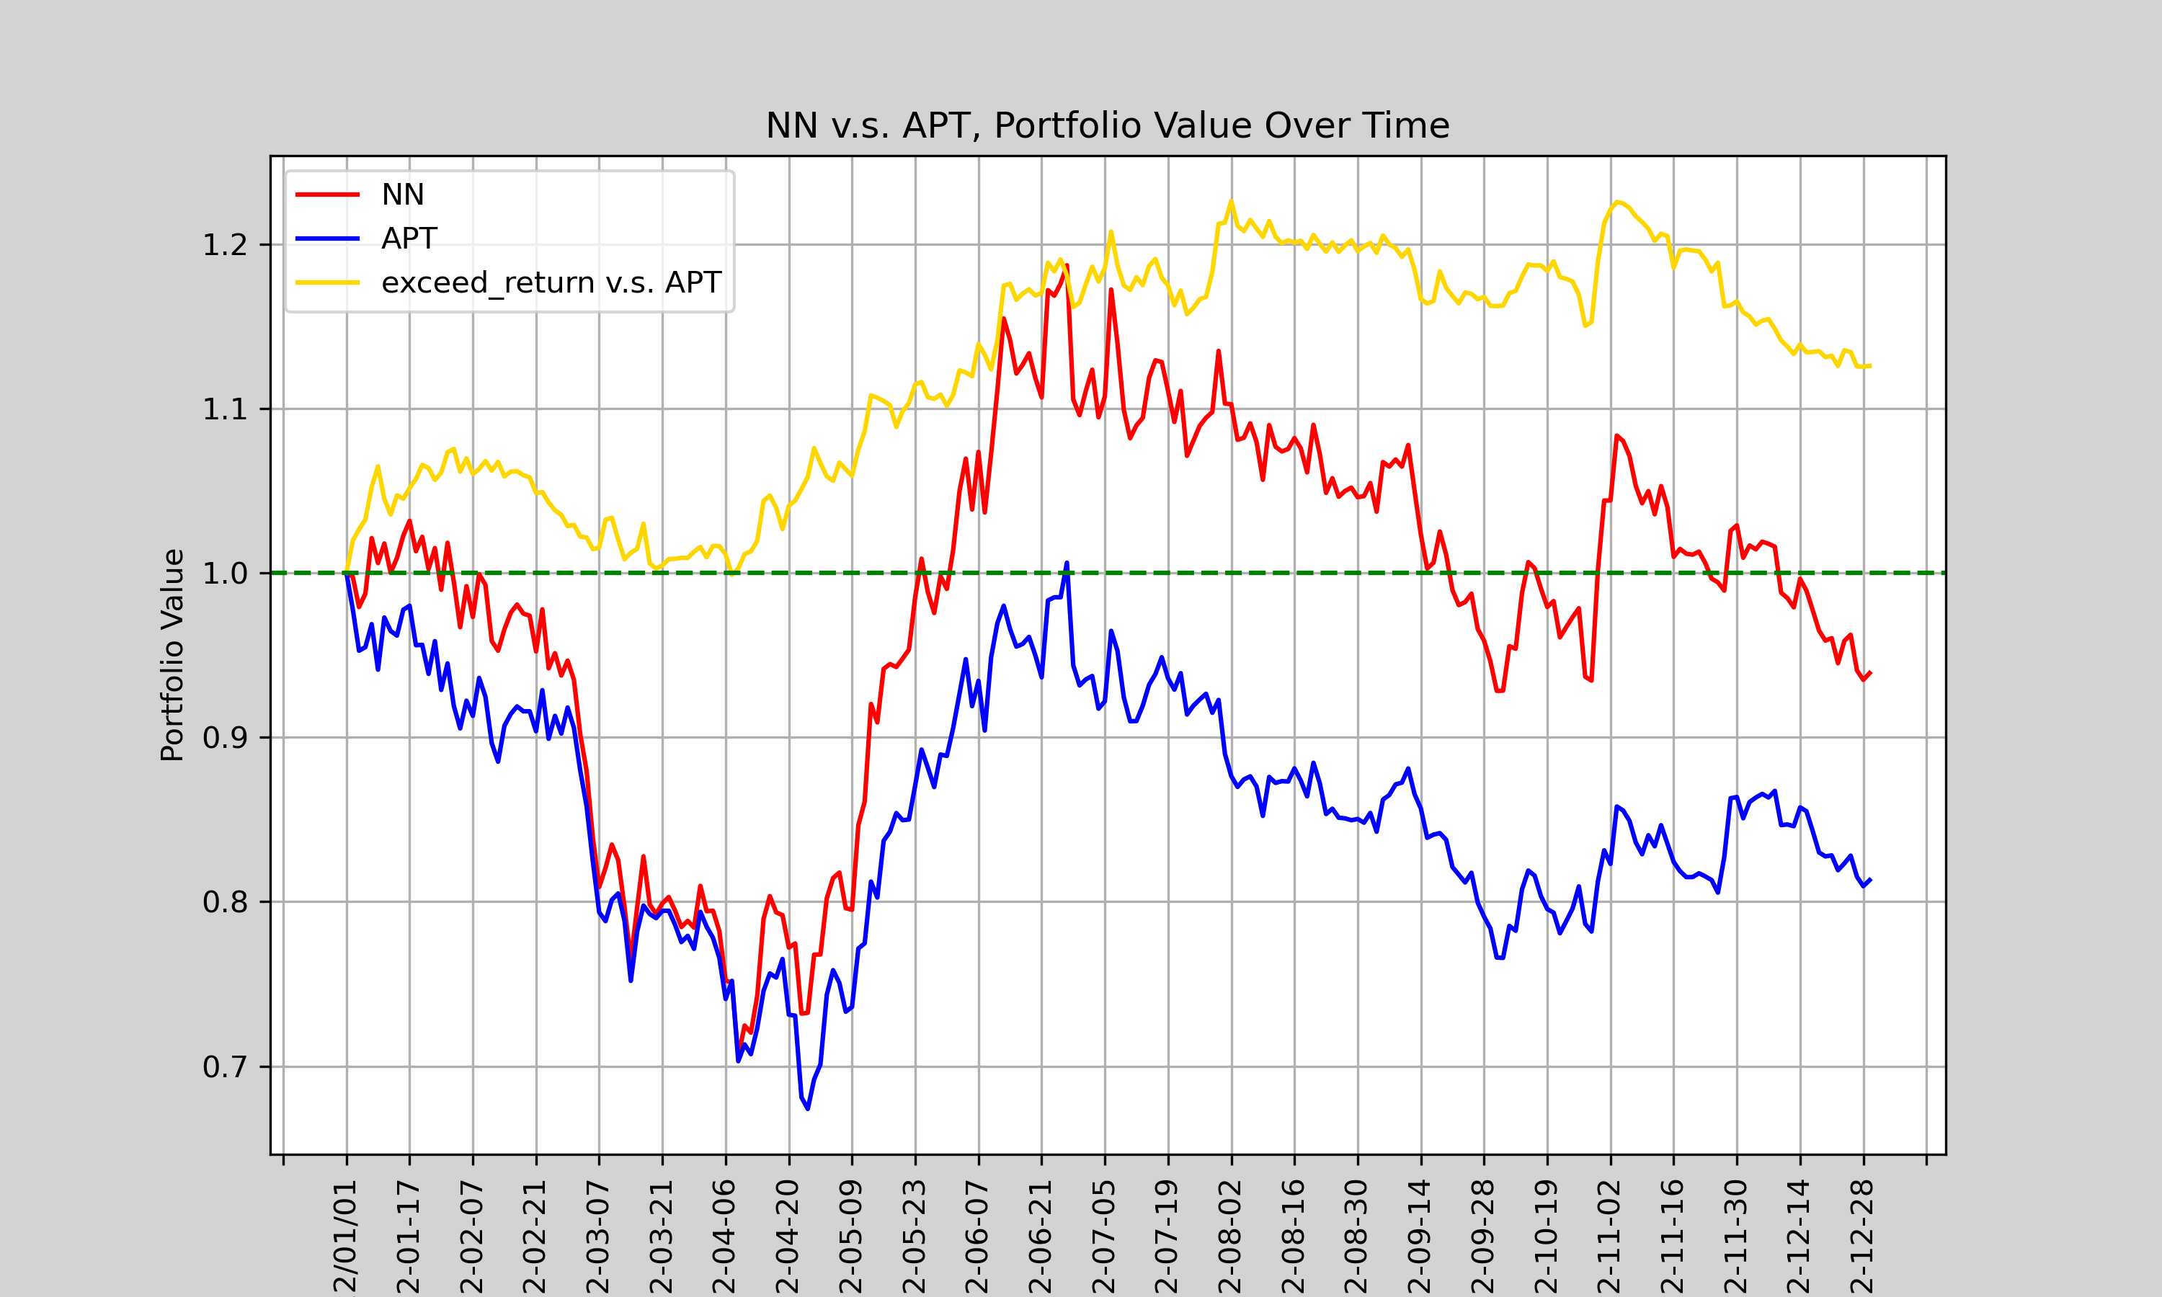
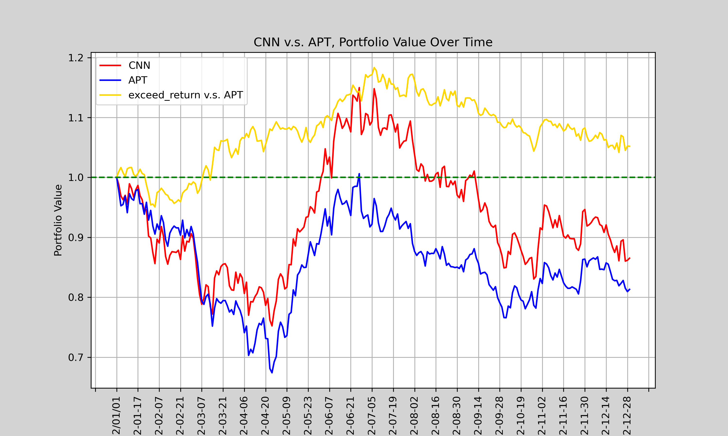
Sharpe ratio of models
All of the portfolios’ return is negative in this period.
We measure the Sharpe ratio of exceed return.
lightGBM
XGBoost
LASSO
NN
CNN

Slide 37
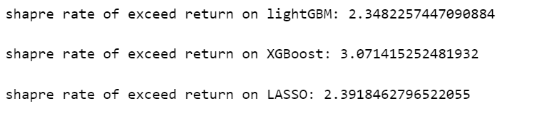
Conclusion：Tree v.s. Linear
lightGBM: 2.34
XGBoost:3.07
LASSO:2.39
The worst tree model is about same as best linear model
The tree model is better than linear model in practice

Slide 38
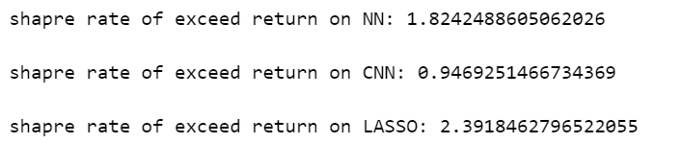
Conclusion：Deep learning v.s. Linear
NN: 1.82
CNN:0.94
LASSO:2.39
The deep learning model is not better than best linear model
Overfitting for NN
Underfitting for CNN

Slide 39
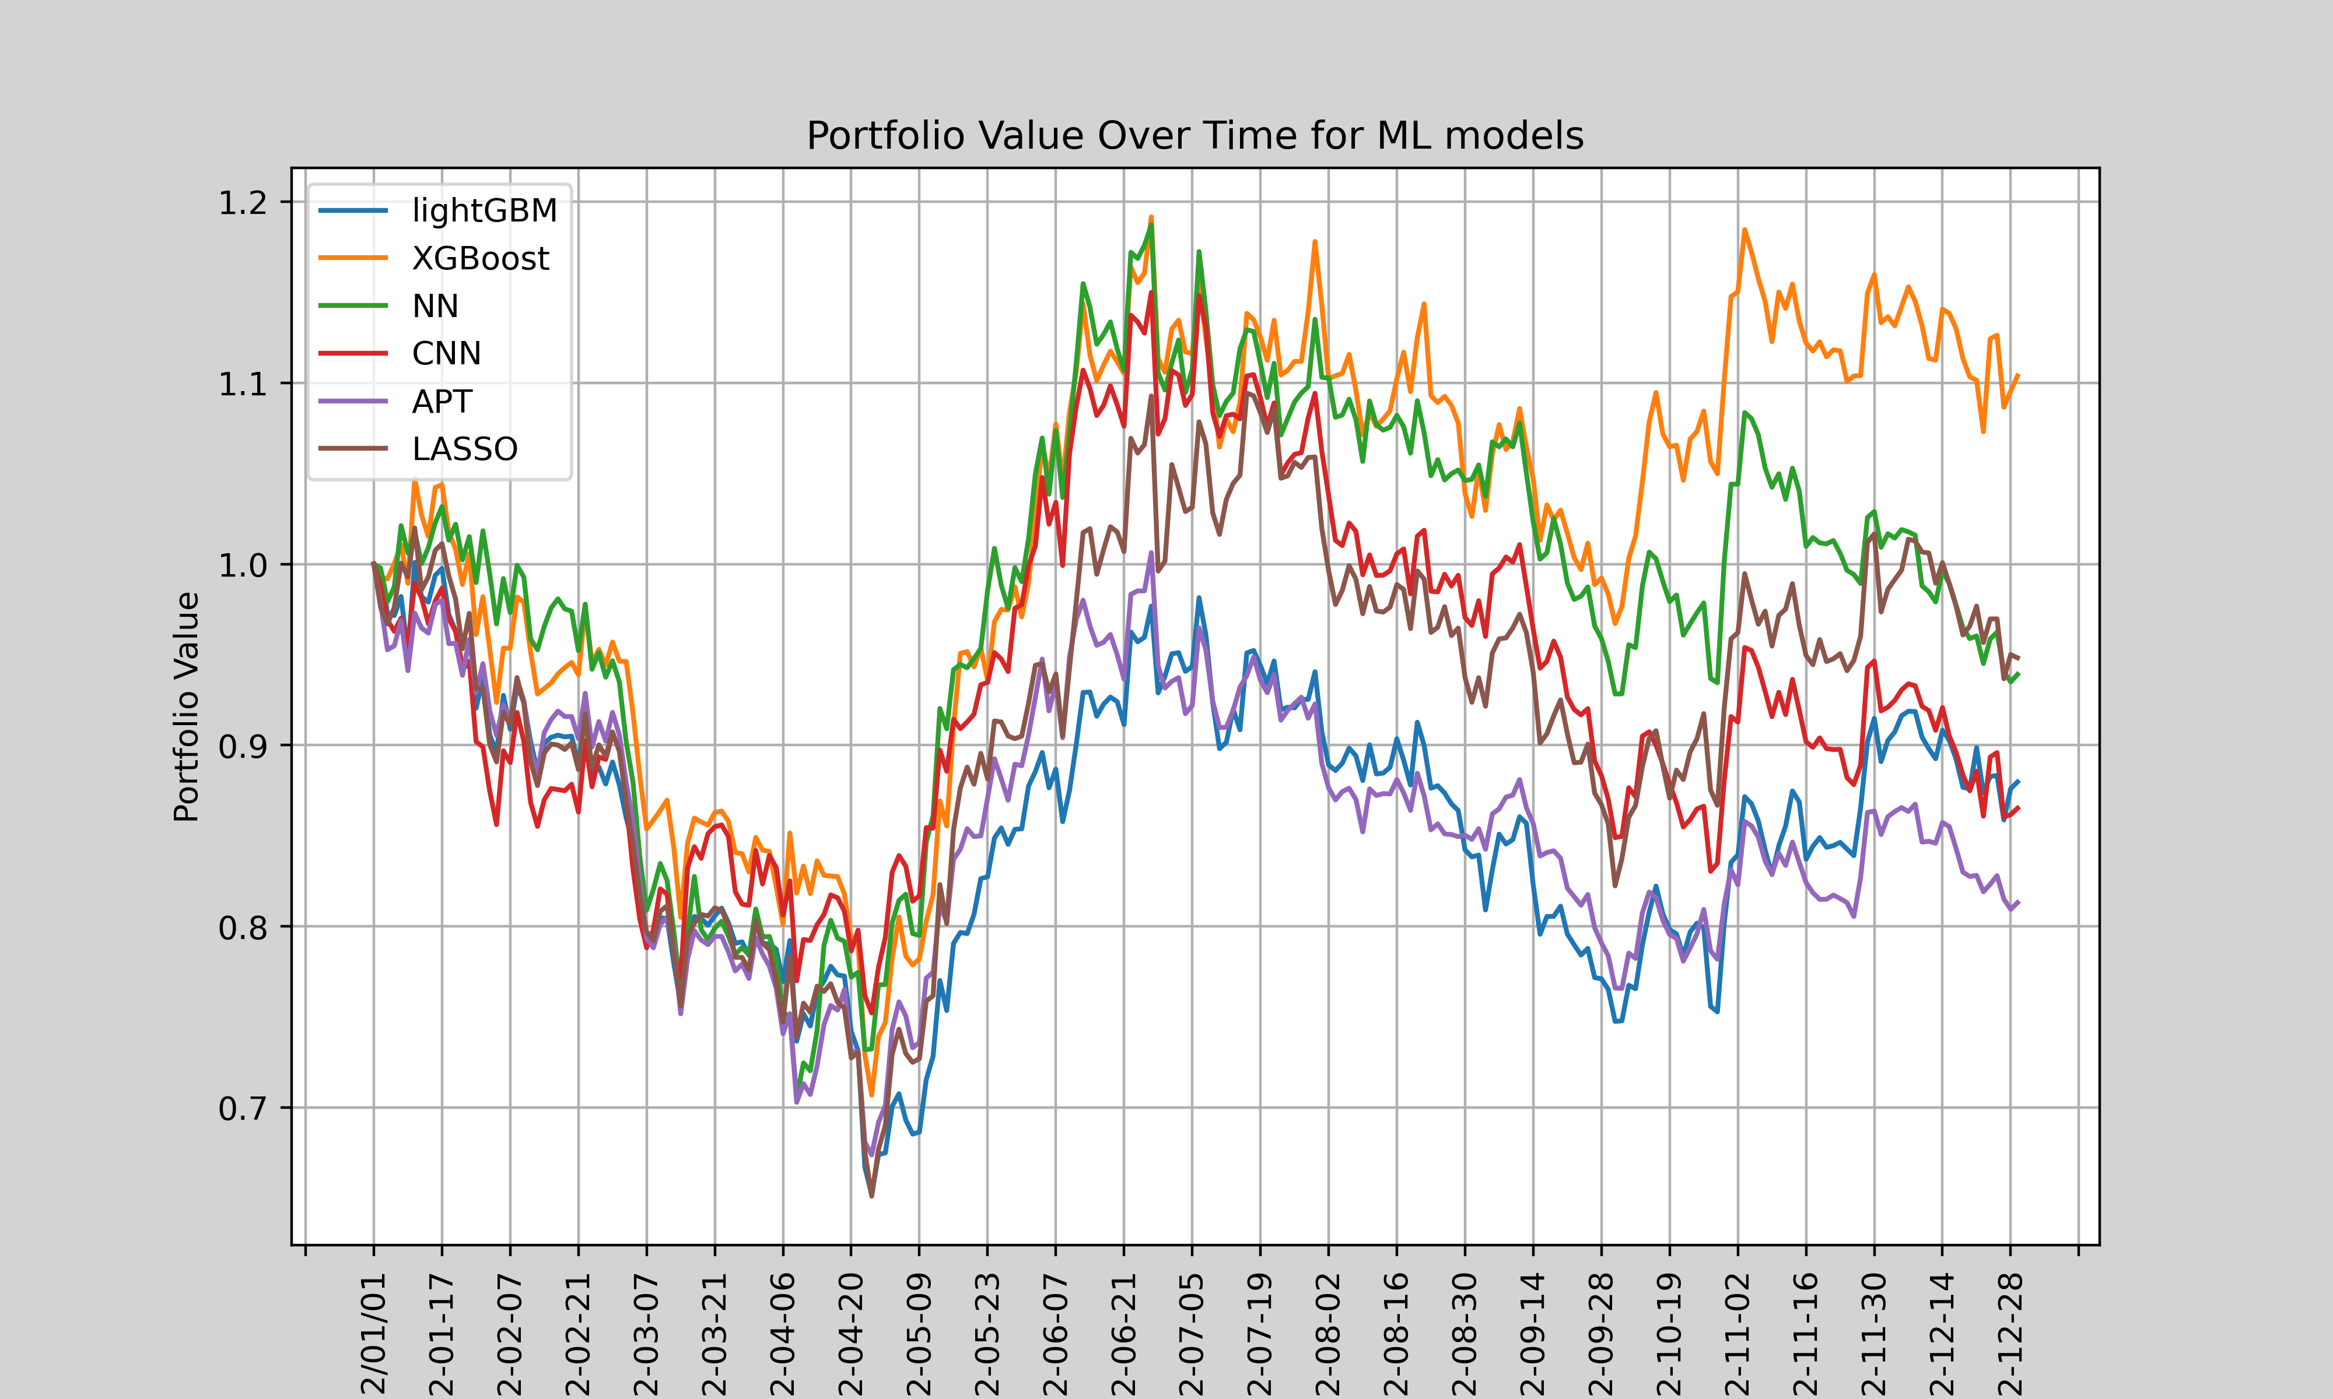
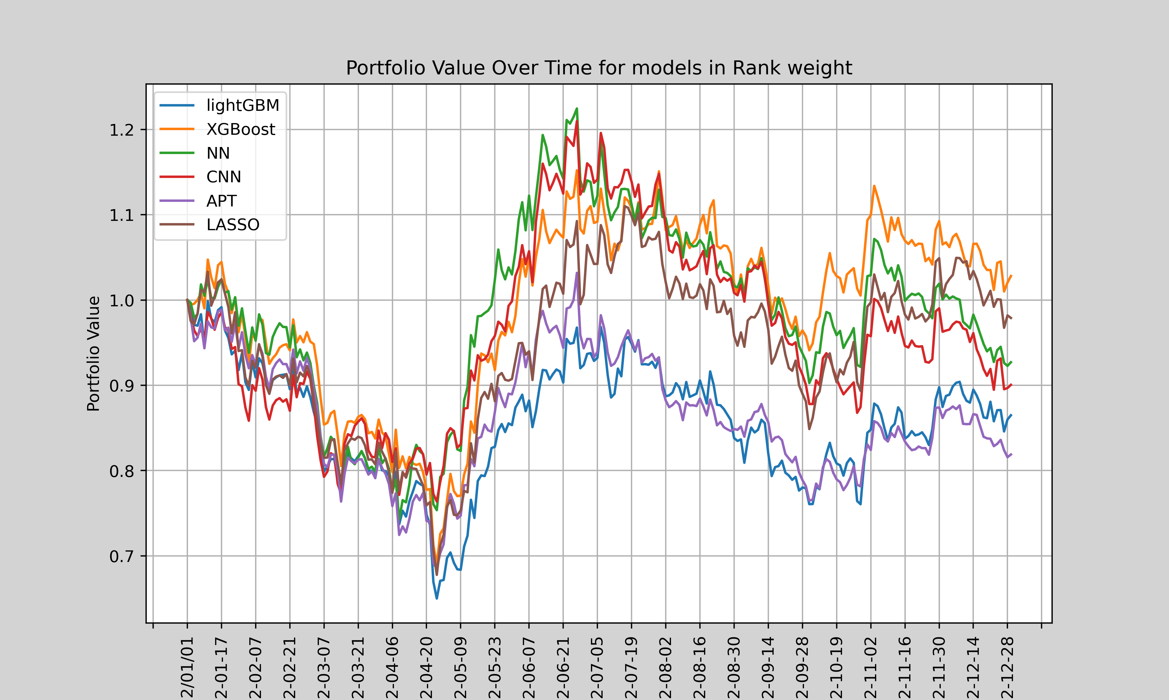
Machine Learning model in different strategies
Deeper:
require less info
based on value
based on rank:
ML model perform worse in “on rank” strategy, Linear regression model remain unchanged
The variation of ML model reduced and converges towards the Linear regression model

Slide 40
Deeper:
Machine Learning model in different strategies
based on value
based on rank:
The return predicted by ML model contains more the information than linear model

Slide 41
Thanks!

